Slide 1
Lecture 9: BA and the Business Intelligence Competency Center (BICC)
Prof. Mike Boyle
Department of Operations and Information Systems
University of Utah

Slide 2
Lecture Outline
Lecture:
Motivation
What is the BICC?
BICC Functions
BICC Competencies
BICC Structure
BICC Position in the Organization
Why/When to Establish a BICC

Slide 3
Recall: Three Pillars of BA
BA Program/Competency
Concept: BA Maturity Level is a function of the organization’s maturity levels for each of the three pillars:
Information Management
Analysis
Culture/Leadership
Information Management Competency
Analysis Competency
Culture/Leadership

Slide 4
Motivation: Factors Impeding the Success of BA
Motivation: The most significant factors impeding the successful creation and execution of BA are related to the Three Pillars of BA:
Lack of either or both of the following competencies:
Information Management
Analysis
Inappropriate organizational structure given:
The BA needs of the organization (e.g. strategic vs. operational)
The depth and breadth of data-driven decision-making within the organizational culture

Slide 5
Motivation: “Big Data, Analytics and the Path From Insights to Value”
Key Findings*:
Top-performing organizations are twice a likely to apply analytics to activities
The biggest challenges in adopting analytics are managerial and cultural
Visualizing data differently will become increasingly valuable
* Source: LaValle et al, “Big Data, Analytics and the Path From Insights to Value” MIT Sloan Management Review (2011)

Slide 6
What is the Business Intelligence Competency Center (BICC)?
The BICC is a business unit responsible for the analytical (analysis competency pillar), business (culture/leadership pillar) and IT (information management pillar) competencies that are required for the success of BA

Slide 7
What does BA look like without a BICC?
Discussion: Which pillar(s) need to be addressed in each scenario?
Scenario 1:
There is an IT/Database “go-to” person for data requests
Variability in how much/what data is available/accessible
If not available, data not used in decision-making process
Generally reactive to analytical requests
Scenario 2:
Similar to Scenario 1 as well as the following:
Someone who has been there for a long time acts as the subject matter expert (SME):
SME knows the organization well
May not use analytics, rather, the SME’s opinion

Slide 8
What does BA look like without a BICC? (cont’d)
Discussion (cont’d): Which pillar(s) need to be addressed in each scenario?
Scenario 3:
Organization is moving toward better, centralized, integrated data from siloed, data islands
E.g. of common problem: Two employees from the same department (e.g. Finance) may have data supporting the same decision that is unexpectedly different
Likely causes:
Data was pulled from separate sources
Data was pulled from the same source with different queries

Slide 9
What does BA look like without a BICC? (cont’d)
Discussion (cont’d): Which pillar(s) need to be addressed in each scenario?
Scenario n:
(What is your organization’s scenario?)

Slide 10
BICC Functions
Efficiently links Organizational Strategy to the Information Strategy
Provides the needed critical mass for BA to become successful:
(analysis pillar) Unified efforts and voice from analysis competency across the organization
Ensures efficacy to the analysis process
Manages growth of analysis competency within the organization

Slide 11
BICC Functions (cont’d)
Provides the needed critical mass for BA to become successful:
(information management pillar) User-friendly, information-need-aligned, cost-effective Information Management Systems
Manages relationships with end-users to ensure their experience with the Information Management Systems are effective and efficient
Ensures that the information provided is aligned with the current needs of the business
Manages relationships with IT to minimize technology costs related to BA
(leadership/culture pillar) Manages prioritization of BA projects
(leadership/culture pillar) Responsible for organizational Knowledge Management

Slide 12
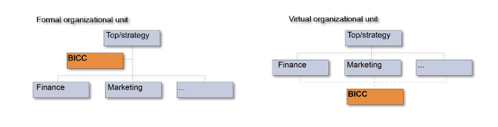
BICC Structure: Centralized vs. Decentralized
When the BICC is located close to:
the executive level of the organization, it is more likely to impact strategic decision-making and initiatives
Recall: “Holistic: Information is being treated as a strategic resource, which can be used to determine company strategy. The organization constantly evaluates how it can compete on information when creating strategies.”
where analysis is being done by analysts, it is more likely to improve the operational performance of the given business processes

Slide 13
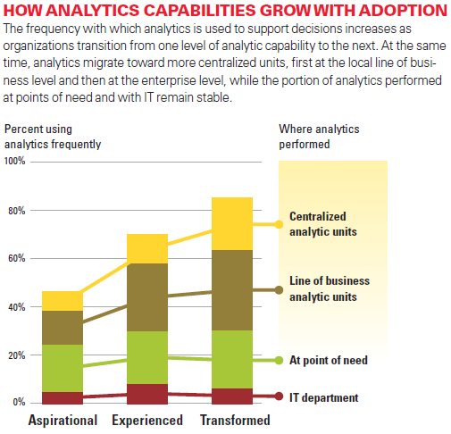
BICC Structure: Centralized vs. Decentralized (cont’d)

Slide 14
BICC Structure: Centralized vs. Decentralized (cont’d)
Important:
Whether BICC is centralized or decentralized, it still has the same general functions
(See “BICC Functions” slides above)

Slide 15

Don’t do it!: Analysts Reporting to IT Department
Why would an organization rationalize having analysts reporting within IT Department?
Close to data and the BI Engineers, Software Engineers, etc.
Logical career progression from Information Management into Analysis
Technical skills to manage/manipulate data are high in the IT Department which is important to being an effective Analyst
(All good rationalizations, but in most cases an ineffective organizational structure)
The reason why analysts shouldn’t report to IT:
Analyses will be more directly connected to operational and/or organizational initiatives if they are in departments other than IT
Exception: If IT is a major differentiator for the business, having Analysts in IT may be an effective structure
Don’t do it!

Slide 16
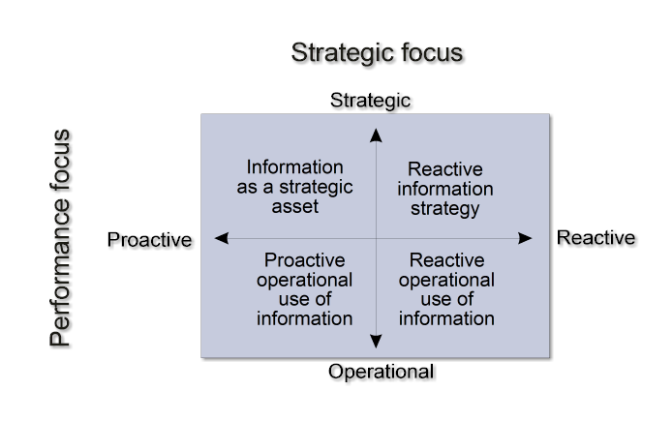
How to Position BICC in Organization
Questions:
Where is your organization currently?
Where do you need your organization to be?
Actions:
Position your BICC according to responses to the above questions

Slide 17
Why/When to Establish the BICC?
Why?
To get relatively more value from BA projects, personnel and BA technology investments
When?
As soon as possible, but right-size it
When there is a large investment in BA
When there is a significant change in strategy and/or operations with respect to use of data

Slide 18
Appendix

Slide 19
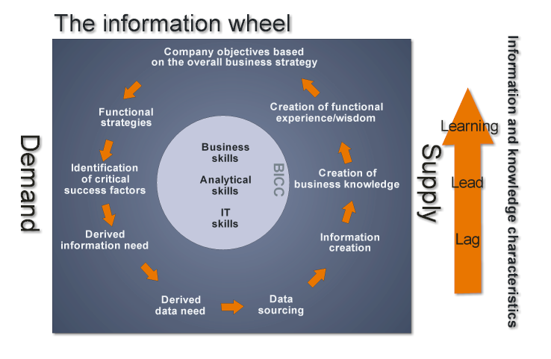
BICC Functions (cont’d)
The BICC is the owner and developer of the Information Wheels in the organization
Concept: There is an Information Wheel per process
BICC manages synergies between Information Wheels

Slide 20
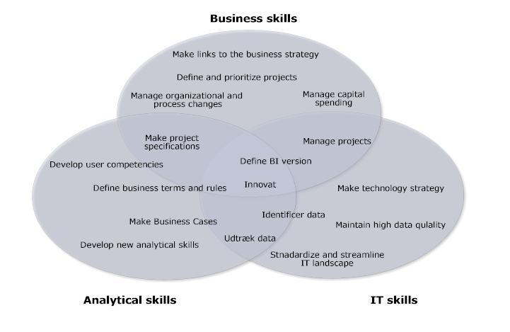
BICC Competencies
Discussion:
How would an organization use this framework?
Organization should:
baseline itself across these competencies
Periodically review improvements or degradations

